Slide 1

Into the storm: Uncovering the narrative of QAnon
Ioana Frincu (s1904914)
Supervisor: Menno de Jong
BSc. Communication Science

Slide 2
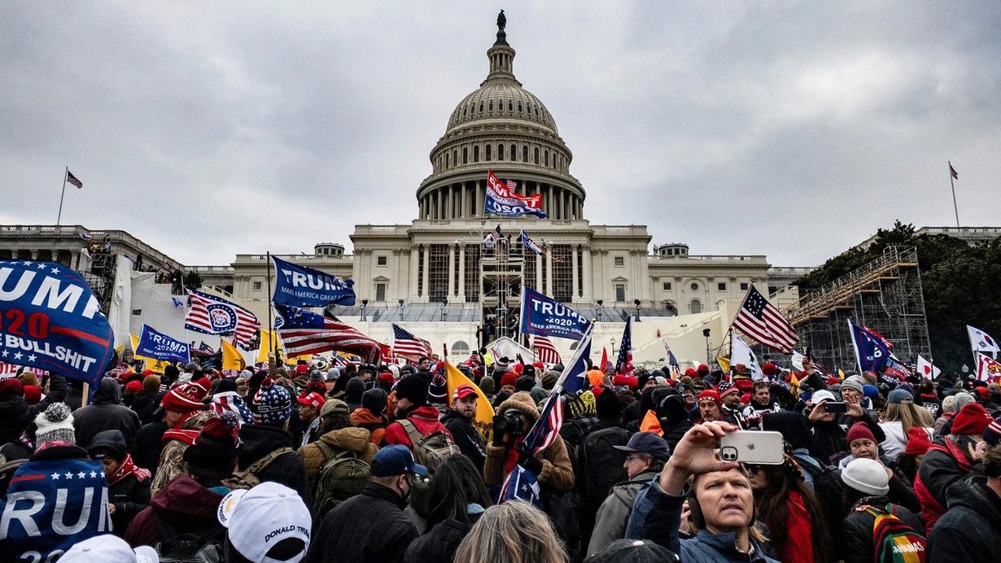

Slide 3
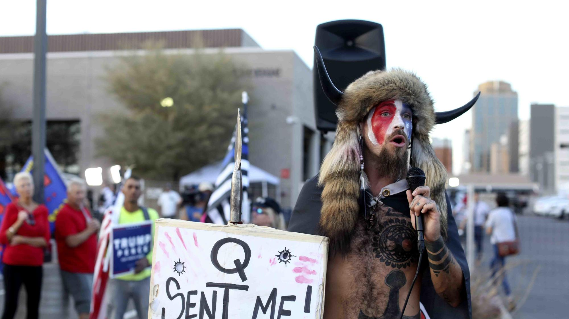

Slide 4

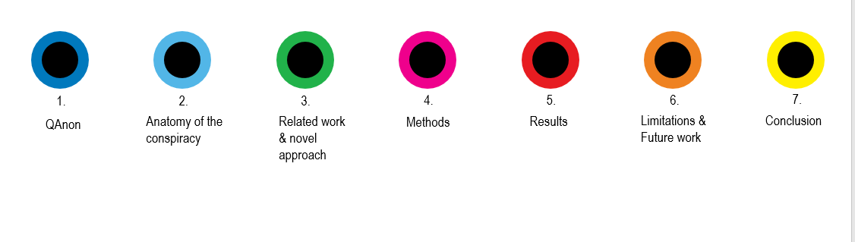
IN THIS PRESENTATION:

Slide 5
Meet Q and the QAnon
1
Short introduction

Slide 6
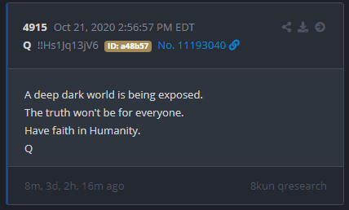
Q
Important facts
First post by Q was on 4chan in 2017 and last one in January 2021 on 8kun
Mega conspiracy
FBI labelled it as “domestic violent threat”
WWG1WGA = where we go one, we go all

Slide 8
QAnon is global
40%

Slide 9
What is the narrative of QAnon?
Research Question:
+ Who are the Qanon followers ?
+ Other exploratory findings

Slide 10
Anatomy of conspiracy theory
2
The main elements part of the conceptual framework

Slide 11
The anatomy tof conspiracy theories and conspiracy thinkers
Storytelling
Narrative, actors, events, genre, archetypes
Psychological traits
Apohenia, lack of control, negative outlook, traumatic experiences, paranoia, mental diseases
Conceptual Framework
Media
Social media, Alt-tech, Fake news, Mass media
Group dynamics
Ingroup and outgroup divide, “us vs them” mentality, scout and soldier mentality
Cultural background
Distrust in instituions, geographical influences, internalized attitudes
Ideologies
Christian values, conservative values, political partisenships

Slide 12
Methods
5
Narrative inquiry

Slide 13
6,432 posts
Yes, that took a while to code

Slide 14
r/QAnon_Casualties
“Soros controls the organizations to create and exploit divisions between people (Antifa, BLM) and keep them trapped in identity politics through propaganda”
“She spends hours a day on Facebook and YouTube. She just sits in her echo chamber all day hearing conspiracy after conspiracy which manipulates her into feeling bad. I have no chance of winning this.”
“The WWG1WGA crowd is stunningly making excuses and waiting for the "facts" on Matt Gaetz being accused of trafficking a 17 year old for sex. “.
Q drop + 8kun threads
r/Qult_Headquarters

Slide 15
7 categories
27 subcodes
3 main themes
Event, Actor, Action, Beliefs, Consequences, Religiousness, Relationships
Eg : JoeBide, Inauguration, Child trafficking
Total success!

Slide 16
Results
6
The most important part of the presentation

Slide 17
What is the Qanon narrative
Patriots against the elites
Discrediting the establishment
Cult behavior
Trump = hero
Q = ominous narrator
Democrats & co. = villains (part of the “cabal”)
Digital soldiers= the QAnon followers

Slide 18
Results
Three types of QAnon followers
The contributor, the spreaders, the terrorist
Consequences
Strained relationships
Overpolluate the mainstream media
Disupting public and political discourse
Extreme acts of violence
QAnon only reinfornce pre-existent beliefs in most cases
This new type of conspiracy is just the beginning

Slide 19
Limitations and future research
6
Academia needs to pay more attention to conspiracy theories

Slide 20
A starting point
Limitations:
The validity of data & personal bias
My research
Future research : media labels, Qanon followers' characteristics, storytelling in conspiracies, transition from alt-tech to mainstream, more precise research questions.

Slide 21
Conclusion
6
Looking from different perspectives can improve our understanding of shocking and traumatic situations.

Slide 22
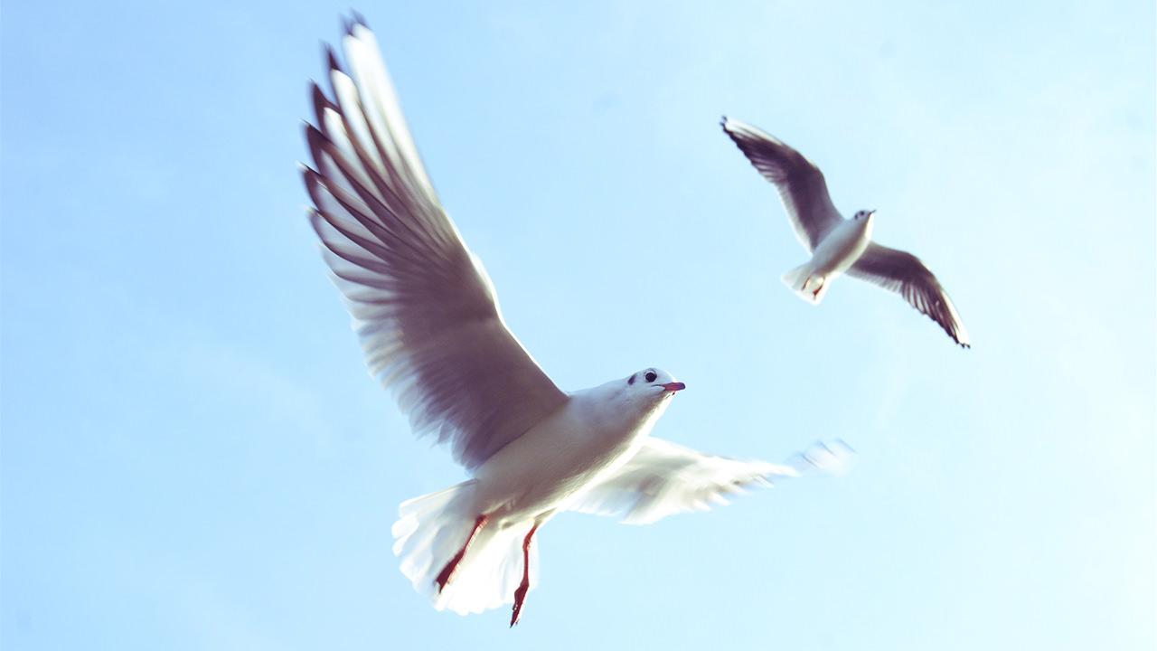
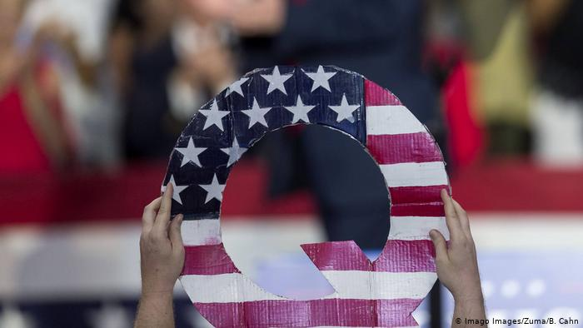
Alaways exercise cautios when you are online.

